Slide 1
CSE 203: Data Structures and Algorithms I

Slide 2



Algorithms and Data Structures
An algorithm is a step-by-step procedure for performing some task in a finite amount of time.
Typically, an algorithm takes input data and produces an output based upon it.
A data structure is a systematic way of organizing and accessing data.
Input
Algorithm
Output

Slide 3
DSA working together…
Data Structure:
A way of organizing, storing, accessing, and updating data
Examples: Arrays, Linked Lists, Stacks, Queues, Trees
Algorithm:
A series of precise instructions to produce a specific outcome
Examples: Binary Search, Merge Sort, Recursive Backtracking
DSA in a Program:
A program is the expression of an algorithm in a programming language
Data Structure + Algorithms
Binary Search Tree + Tree Traversal

Slide 4
Goals of this Course
In this course, we will look at:
Algorithms for solving problems efficiently
Data structures for efficiently storing, accessing, and modifying data
We will see that all data structures have trade-offs
There is no ultimate data structure...
The choice depends on our requirements

Slide 5
Goals of this Course
Reinforce the concept that costs and benefits exist for every data structure/algorithm.
Learn the commonly used/important data structures/algorithmic techniques.
These form a programmer's basic data structure “toolkit”.‘
Understand how to measure the cost of a data structure or algorithm.
These techniques also allow you to judge the merits of new data structures/algorithms that you or others might invent.
Notes:
The first goal is a worldview to adopt
The second goal is the “nuts and bolts” of the course.
The third goal prepares a student for the future.

Slide 6

Tradeoff Examples
Consider accessing the kth entry in an array or linked list (!)
In an array, we can access it using an index array[k]
You will learn later that there is a single machine instruction for this
We must step through the first k – 1 nodes in a linked list
We will learn this in this course
Consider searching for an entry in a sorted array or linked list
In a sorted array, we use a fast binary search (!)
Very fast: O(log n)!!!!!
In a linked list we must step through all entries less than the entry we’re looking for
Slow

Slide 7
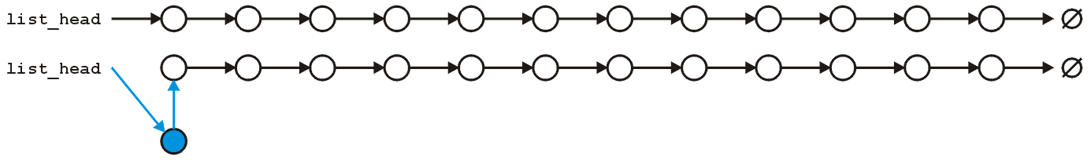
Tradeoff Examples
However, consider inserting a new entry to the start of an array or a linked list
An array requires that you copy all the elements in the array over
Slow for large arrays
A linked list allows you to make the insertion very quickly
Very fast regardless of size

Slide 8
The Need for Data Structures
Data structures organize data
⇒ more efficient programs.
More powerful computers
⇒ more complex applications.
More complex applications demand more calculations.
Complex computing tasks are unlike our everyday experience.
How important is it?
Can we just think of more powerful computers instead?
Notes:
A primary concern for this course is efficiency.
You might believe that faster computers make it unnecessary to be concerned with efficiency. However…
So we need special training.

Slide 9
Need for DS: Organizing Data
Any organization for a collection of records can be searched, processed in any order, or modified.
The choice of data structure and algorithm can make the difference between a program running in a few seconds or many days.
Notes:
If you are willing to pay enough in time delay. Example: Simple unordered array of records.

Slide 10
Need for DS: Efficiency
A solution is said to be efficient if it solves the problem within its resource constraints.
Space
Time
The cost of a solution is the amount of resources that the solution consumes.
BTW, when we talk about the ‘time’ efficiency, we actually refer to algorithm related to that DS.
Notes:
Alternate definition: Better than known alternatives (“relatively efficient”).
Space and time are typical constraints for programs.
This does not mean always strive for the most efficient program. If the program operates well within resource constraints, there is no benefit to making it faster or smaller.

Slide 11
An example scenario…
3 × 10^6 items, i.e., 3M.
User wants to look up each item at least once
=> 3M searches at least in this application
If each search inspects each item
3 × 10^6 × 3 × 10^6 = 9 × 10^12 inspections at least.
My PC is 3GHz
3 * 10^9 operations/sec
3000 s (50 m) required for this application
How to improve?

Slide 12
An example scenario…
3 × 10^6 items, i.e., 3M.
User wants to look up each item at least once
=> 3M searches at least in this application
If each search inspects each item
3 × 10^6 × 3 × 10^6 = 9 × 10^12 inspections at least.
My PC is 3GHz
3 * 10^9 operations/sec
3000 s (50 m) required for this application
6 GHz => 25 m
Increased to 4M items =>~53 m

Slide 13
An example scenario…
3 × 10^6 items, i.e., 3M.
User wants to look up each item at least once
=> 3M searches at least in this application
If each search inspects each item
3 × 10^6 × 3 × 10^6 = 9 × 10^12 inspections at least.
My PC is 3GHz
3 * 10^9 operations/sec
3000 s (50 m) required for this application
check half of the items => 25 m
Now, 4M items => ~45 m
6 GHz => 25 m
Increased to 4M items =>~53 m

Slide 14
Selecting a Data Structure
Select a data structure as follows:
Analyze the problem to determine the basic operations that must be supported.
Quantify the resource constraints for each operation.
Select the data structure that best meets these requirements.
Organization
Efficiency
Notes:
Typically want the “simplest” data structure that will meet the requirements.

Slide 15
Some Questions to Ask
Are all data inserted into the data structure at the beginning, or are insertions interspersed with other operations?
Can data be deleted?
Are all data processed in some well-defined order, or is random access allowed?
Notes:
These questions often help to narrow the possibilities.
If data can be deleted, a more complex representation is typically required.

Slide 16
Costs and Benefits
Each data structure has costs and benefits.
Rarely is one data structure better than another in all situations.
Any data structure requires:
space for each data item it stores,
time to perform each basic operation,
programming effort.
Notes:
The space required includes data and overhead.
Some data structures/algorithms are more complicated than others.

Slide 17
Costs and Benefits (cont)
Each problem has constraints on available space and time.
Only after a careful analysis of problem characteristics can we know the best data structure for the task.

Slide 18
(returning to) Algorithms
A computational problem is a mathematical problem, specified by an input/output relation.
An algorithm is a computational procedure for solving a computational problem.
Example Problem: FindMax- Find the maximum element of a sequence of numbers
Input: A sequence of n numbers a_1…a_n
Output: The number a_k (k ∈ {1..n}) such that a_k >= a_i for ∀i ∈ {1..n}
Example:
Input: 31, 41, 59, 26, 41, 58
Output: 59

Slide 19
(returning to) Algorithms
Example Problem: Sorting
Input: A sequence of n numbers a_1…a_n
Output: the permutation (reordering) of the input sequence such that a_1 ≤ a_2 ≤ … ≤ a_n
Example:
Input: sequence 31, 41, 59, 26, 41, 58
Output: sequence 26, 31, 41, 41, 58, 59
Can we use:
Sorting to solve FindMax?
FindMax to solve Sorting?
(celebrated) Algorithms for sorting: quick sort, merge sort, bubble sort…
We will return to these questions soon

Slide 20
(returning to) Algorithms
Three concepts
Expressing an algorithm
Correctness of an algorithm
Efficiency of an algorithm
Similar to DS efficiency

Slide 21
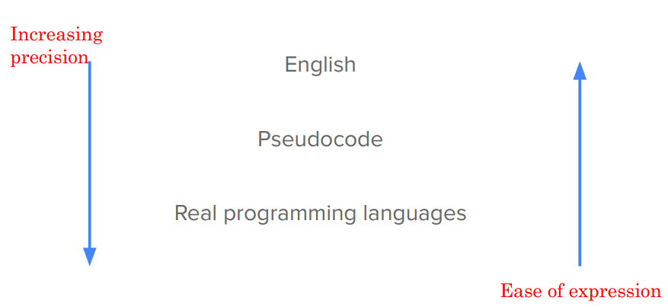
How to express an algorithm

Slide 22
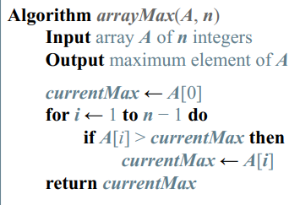
pseudocode
High level description of an algorithm
More structured than English prose
Less detailed than a program (code)
Hides programming language specific details and design issues.

Slide 23
Correctness
How do you know an algorithm is correct?
For every input instance, it halts with the correct output
Since there are usually infinitely many inputs, it is not trivial
Incorrect algorithms
Might not halt at all on some input instances
Might halt with other than the desired answer

Slide 24
Efficiency
To sort n numbers:
we can enumerate all permutations of these numbers and test which permutation has the correct order
We can use FindMax n times…
To find the maximum
We can sort the sequence and return the last number
How good are these algorithms?
How to measure how good they are?

Slide 25
DSAs in everyday life…
‘Handling’ a file in your computer systems
(Hard)Disks contain millions of blocks
Calling your friend in your cell phone
You need to put the name and the number comes up
Do you need to type the full name?
Log in to gmail/facebook etc.
Somehow your credentials are looked up and matched
1.7 Billion FB users (2020)!
1.8 Billion active gmail users (2020)!

Slide 26
DSAs in everyday life…
Google search
Handling over 3.5 billion searches per day
30 to 50 billion of pages is the size of Google index.
Google Search Index contains more than 100,000,000 GB
Search engine indexing is the collecting, parsing, and storing of data to facilitate fast and accurate information retrieval.
Priority ranking algorithm called PageRank Algorithm
https://firstsiteguide.com/google-search-stats/

Slide 27
Abstract Data Types

Slide 28
Abstract Data Types
Abstract Data Type (ADT): a definition for a data type solely in terms of a set of values and a set of operations on that data type.
Each ADT operation is defined by its inputs and outputs.
Hide implementation details.
In a program, we implement an ADT, then think only about the ADT, not its implementation

Slide 29
Data Structure
A data structure is the physical implementation of an ADT.
Each operation associated with the ADT is implemented by one or more subroutines in the implementation.
Data structure usually refers to an organization for data in main memory.

Slide 30
Logical vs. Physical Form
Data items have both a logical and a physical form.
Logical form: definition of the data item within an ADT.
Ex: Integers in mathematical sense: +, -
Physical form: implementation of the data item within a data structure.
Ex: 16/32 bit integers, overflow.

Slide 31
Data Type
ADT:
Type
Operations
Data Items:
Logical Form
Data Structure:
Storage Space
Subroutines
Data Items:
Physical Form
Notes:
In this class, we frequently move above and below “the line” separating logical and physical forms.

